Slide 1
CODACC Program Objectives, goals, Schedules, and Logistics
June, 2021

Slide 2
Objectives
The Colorado Diverse Attorney Community Circle (CODACC) Program seeks to build a community for diverse Colorado attorneys amongst
Attorneys of different backgrounds, especially those from historically underrepresented populations
Attorneys in private practice, government, judicial, and in-house
Attorneys of all practice areas
Attorneys from all geographic locations

Slide 3
Objectives (CONT.)
CODACC will:
Invite participants to explore where they belong within the Colorado legal profession and the Colorado Bar Association (“CBA”) and to make diverse and allied friends and business contacts who they would not have otherwise met through their employers or other legal community groups in which they participate.
Train participants in core Racial Justice, Equity, Diversity, and Inclusivity (“REDI”) competencies and how to present EDI-related CLEs, and open doors for such presentations.
Create an individualized development plan that addresses professional and personal opportunities and growth, business development, networking, and community engagement and involvement.
Promote mentorship and networking opportunities for diverse attorneys, with the use of mentorship pods and regularly facilitated conversations and events within each mentorship pod and the CBA and its sections. The program year will be equally divided to address Equity, Diversity, and Inclusivity to provide each participant more history, knowledge, and tactics for addressing each.
Open doors for diverse attorneys to take more leadership positions in in their workplaces, the CBA, the community, and in their own practices.

Slide 4
Objectives (CONT.)
CODACC will provide diverse attorneys with five specific sets of programming:
Regular networking and affinity events and retreats that involves participation from groups within and external to the CBA, including affinity bars, CBA sections, and business organizations
Public service opportunities
Bimonthly REDI CLEs and activities
Mentoring relationships & presentation capabilities
Business development and networking skills

Slide 5
CODACC Class of 2022
CODACC Class of 2022 will host many open houses and will have opportunities to invite broad CBA member engagement.
The CODACC Planning Committee will be part of the initial core participants and will serve as ambassadors to the program.
The Planning Committee will create a selection process for future participants that will allow those interested to share their diversity story and their commitment to the CBA’s REDI-related mission, vision, and values.
With the use of mentorship pods, CODACC will be scaled to be a large and inclusive program while it maintains a more personal feel.
The selection process for non-Committee participants are expected to go live sometime in November 2021.
This will allow:
The Program to be more inclusive.
Firm, business, and CBA section sponsors to fund their own employees in the program if their applications are accepted.
A larger, more diverse pool for networking and professional development

Slide 6
CODACC Planning Committee 2021
Spencer Rubin (co-chair), CBA YLD Chair, Associate at Bryan Cave, Denver Metro
Jon Olafson (co-chair), CBA EC REDI Chair, Partner at Lewis Brisbois, Denver Metro
Stephanie Natsuko McConkie, CLI YLD Chair, Associate at Bradford, LTD, Denver Metro
Marika Rietsema Ball, CLI YLD Chair-Elect, Associate at Jones & Keller, Denver Metro
Danita Alderton, Attorney at Altman, Keilbach, Lytle, Parlapiano & Ware, Pueblo
The Hon. Chief Judge Susan Blanco, 8th Judicial District, Fort Collins
Lauren Concepcion, Trademark Counsel at Legal Zoom, Boulder
Leslie German, 7th Judicial District Family Court Facilitator, Ridgway
Jason Kelly, Alamosa County Attorney, Alamosa
The Hon. Judge Lance Timbreza, 21st Judicial District, Grand Junction
Sumi Lee, Head of Judicial Diversity Outreach for the Colorado Judicial Branch, Denver Metro
Cabell Massey, Senior Corporate Counsel at Gevo, Inc., Denver Metro
J. Scott Rosenbach, Associate, Husch Blackwell

Slide 7
Selection for CODACC CLASS of 2022 and beyond
The CODACC Planning Committee continues to work on a selection process. The overarching goal of the selection process will move away from a “check the box” model and will be more qualitative and focuses on each applicant’s statement on diversity and the candidate’s diverse experiences.
Applications will be reviewed blindly by CBA Staff and the Planning Committee Co-Chairs.
Ultimately, the goal is to be as inclusive as possible to reflect the diversity of our profession and our professionals.

Slide 8
SAMPLE PROGRAM FLOW

Slide 9
Kick-off Event
August 5, 2021, 5:30-7:30 p.m. – Ruby Hill Park, Denver
Food Trucks
Sponsor Recognition
Networking and program introduction

Slide 10
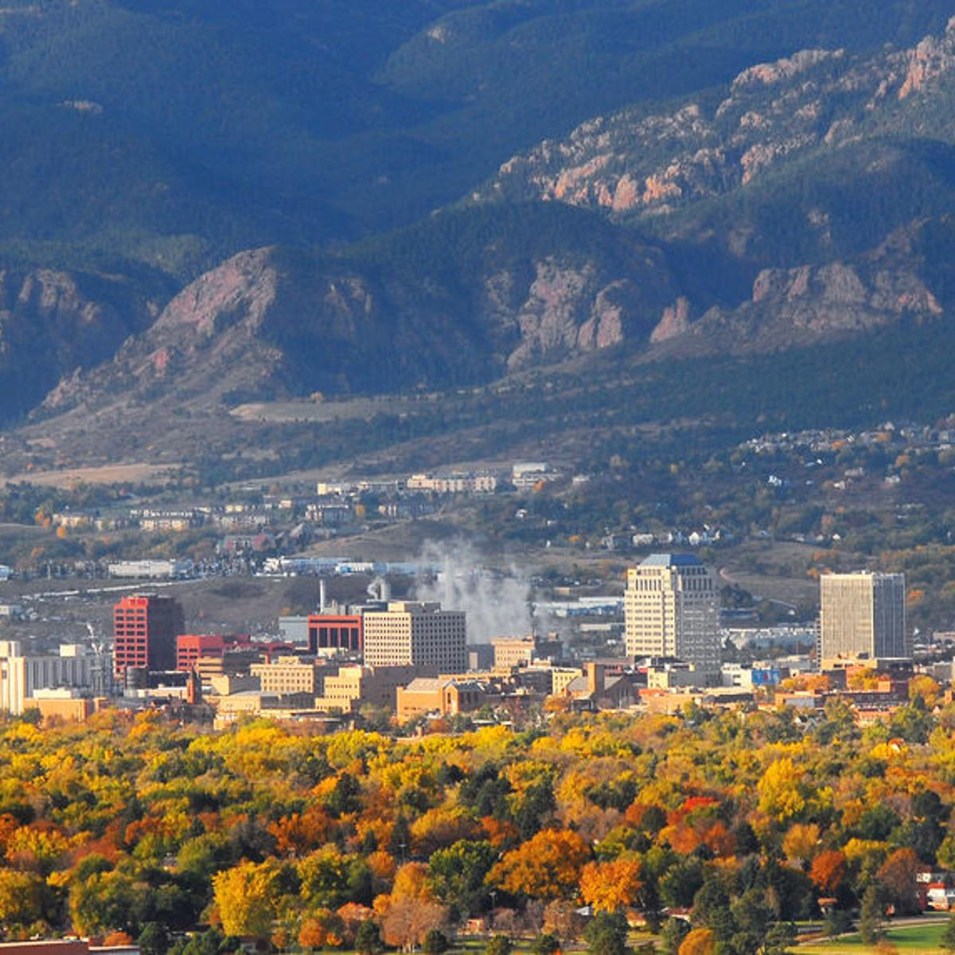
Class Year 1 (2022) TENTATIVE RETREAT SCHEDULE
Friday, April 22 through Sunday April 24, 2022 – Snowmass!! – Theme: Creating Inclusive Communities”
Friday June 10 through Sunday June 12, 2022 – Springs Hotel and Spa, Pagosa Springs, Colorado
August, 2022 Lake Dillon Social Event
Friday September 16 through Sunday September 18, 2022
Retreat will be open to the public and will be structured more as a CLE and implicit bias training symposium with help from CBA-CLE
CODACC Class Year will present REDI CLEs
December, 2022 – Breckenridge, Colorado Winter Social

Slide 11
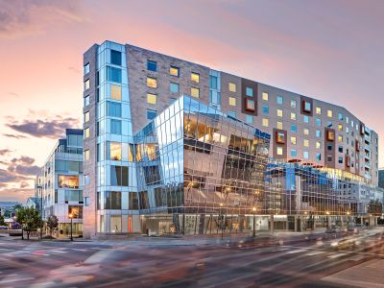
Class Year 1 (2022) Tentative Happy Hour Dates
Thursday, February 24, 2022
Program Inauguration
Dignitaries from across the community will be invited
Sponsors will be featured beginning here and continuing throughout the year of the program

Slide 12
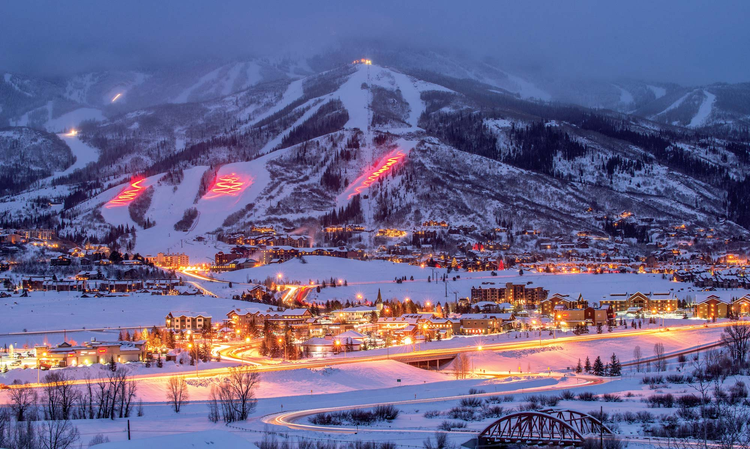
Class Year 2 (2023) Tentative Schedule
Thursday, February 23, 2023 (Kickoff Happy Hour Open to the Public)
Friday, March 22 through Sunday March 24, 2023 (1st Full Retreat)
Thursday, April 20, 2023 (2nd Happy Hour Open to the Public)
Friday June 9 through Sunday June 11, 2023 (2nd Full Retreat)
Thursday, June 29, 2023 (3rd Happy Hour Open to the Public)
Saturday, July 22, 2023 (1st Day-Long Retreat – to Correspond with CBA-CLE Symposium – Open to the Public)
Thursday, August 24, 2023 (4th Happy Hour Open to the Public)
Friday September 15 through Sunday September 17, 2023 (3rd Full Retreat Open to the Public)
Thursday, October 26, 2023 (5th Happy Hour Open to the Public)
Saturday, December 10, 2022 (Conclude Program 2nd Day-Long Retreat)

Slide 13
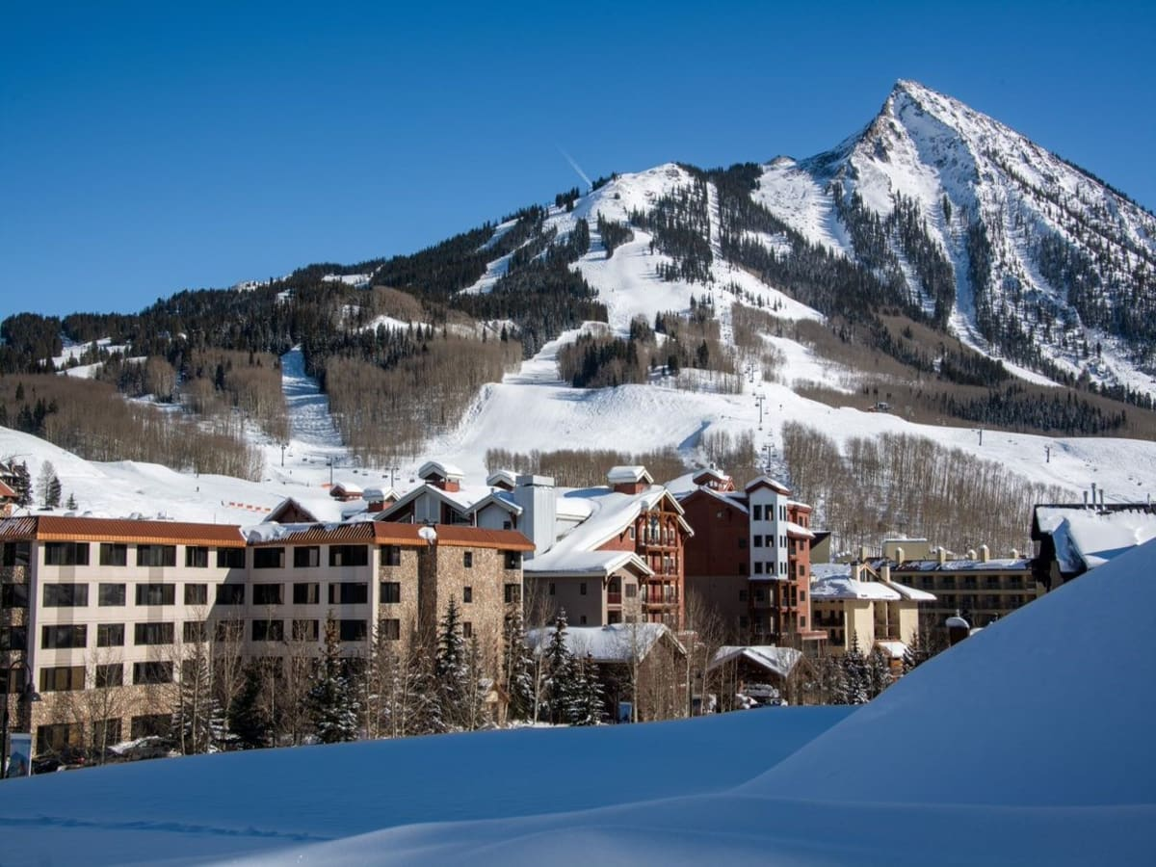
Sample Retreat Schedule
April 22-24, 2022
Venue: Westin Snowmass, Colorado
Creating Inclusive Communities
Friday, April 22
3:00-4:00pm: Arrival and Check-in (Room Costs Covered by Participants / Scholarships)
4:00-5:00pm: Meet in Conference Room; Introduction to 1st Retreat; Discuss Goals of Retreat; Review Weekend Schedule
5:00-6:00pm: REDI CLE; 1 DEI/General Credit
6:00-6:30om: Downtime
6:30pm-8:30pm: Dinner (Covered by CBA)
8:30pm-EOD: Free Networking / Social Time

Slide 14
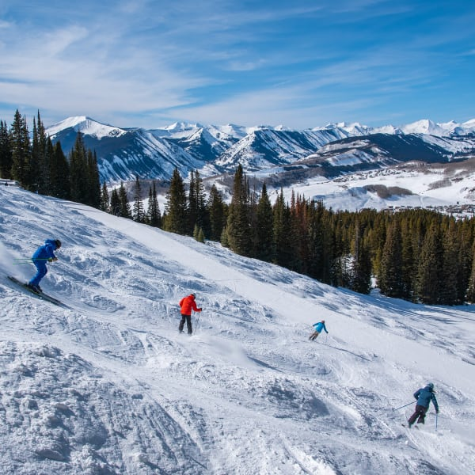
Sample Retreat Schedule (Cont.)
Saturday, April 23
8:00-9:00am: Breakfast (Covered by CBA)
9:00am-12:00pm: Social Networking Activity; skiing, snowshoeing, hiking (Some portion of the activity might by covered by CBA)
12:00pm-12:30pm: Downtime / Return to meeting facility
12:30pm-1:30pm: Lunch (Covered by CBA)
1:30-1:45pm: Break
1:45-3:15pm: Leadership and Business/Professional Development Training Presentation in Conference Room
3:15pm-3:30pm: Break
3:30pm-5:00pm: Mentoring Session OR Trust Building Exercise in Conference Room
5:00-6:00pm: Downtime / Prep for Dinner
6:00-8:00pm: Dinner in Town (Covered by Participants)
8:00pm-EOD: Free Networking / Social Time

Slide 15
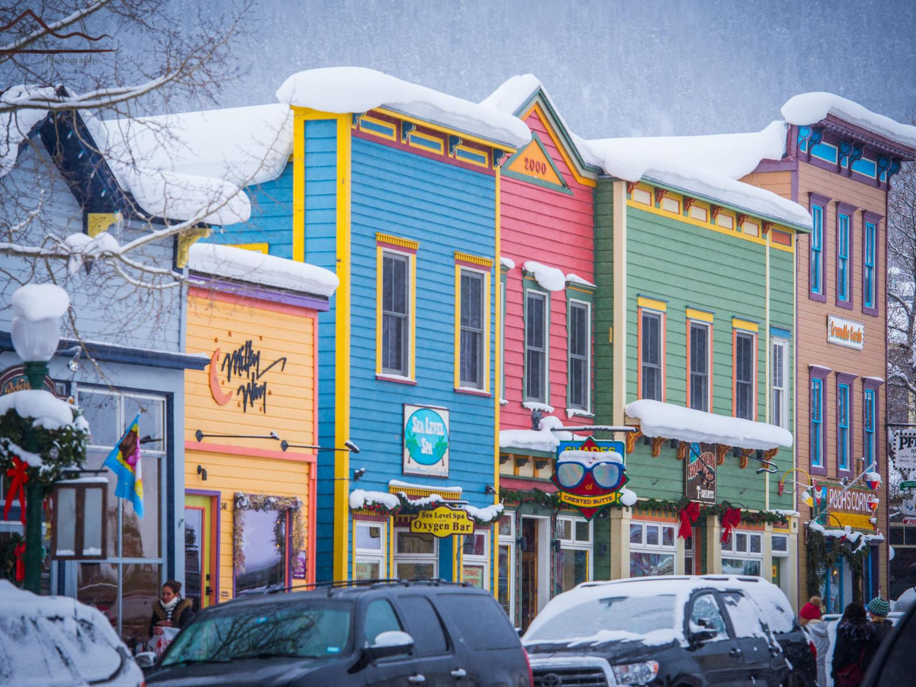
Sample Retreat Schedule (CONT.)
Sunday, April 24
7:00-8:00am: Breakfast (Covered by CBA)
8:00-8:45am: Check-Out
8:45-9:00am: Drive to Public Service Project
9:00am-11:00am: Public Service Project
11:00pm-11:15am: Drive to Lunch in Town (Covered by CBA)
11:15am-12:30pm: Lunch in Town / Announcements for Next Event / Goodbyes
12:30pm: End of Retreat

Slide 16
Sample Happy HOUR PROGRAM
Thursday, February 24, 2022
Potential Venue: Colorado History Museum; hosted by Lewis Brisbois, Denver and via Zoom for Greater Colorado Class Members and Guests
5:00-5:15pm: 1st Annual CODACC Class Kickoff; Remarks by Various People
Invitees to include program participants, CBA dignitaries, Program mentors, Founders’ Circle members, Lewis Brisbois attorneys
5:15pm-6:15pm: Experiential Event related to the LGBTQ+ History in Colorado Forthcoming Exhibit
6:15-7:00pm: Networking
A digital option will also be provided

Slide 17
PLANNING COMMITTEE TACTICS
Existing subcommittees
Retreat / Public Service Planning – Chair: Spencer Rubin
Happy Hour Planning – Chair: Lauren Concepcion
CLE and Leadership Content Development – Chair: The Hon. Lance Timbreza
Mentor Recruitment & Application – Chair: Sumi Lee
Fundraising – Chair: Jon Olafson

Slide 18
Program COSTS & Funding
Seed money from the CBA: $30,000 – APPROVED!!
REDI CLEs
Happy Hours (if sponsors do not pay) (approximately $1K/event; 5 events)
Retreats: meals, conference rooms, and select activities (approximately $7K/event; 3 conferences/program year)
Costs for presenters at events (approximately $4,000)
Estimated cost per participant for full year participation at all events: $2,000 (paid by each participant or by scholarship)
Hotel accommodations at Retreats, to utilize CBA special rates
Travel costs
Select Retreat activities, outside events
The Committee continues to fundraise scholarships to the Program from various firms, CBA Sections, and companies throughout Colorado
Ensure the program is not cost-prohibitive for any participant
Ensure participation from all diverse populations, including those who are socio-economically diverse
Over $42K raised by community partners!

Slide 19
Other Logistics
Financial and Budgetary Process
CBA allocated $30,000 as start-up costs
Program was authorized by the CBA Executive Committee in February 2021;
Budget authorization by the CBA Executive Committee approved in April 2021;
An additional $42,000+ has been raised for scholarships and program costs
CBA Staffing
To help create synergies with COBALT and CBA Sections, Amy Sreenen has engaged with CODACC to assist with programming, including working with Retreat venues and solidifying CLE, leadership, mentoring, and public service project content at Retreats
Other logistical considerations will present themselves as the Committee pursues is tasks

Slide 20
SPONSORS
CBA SECTION SPONSORS
Labor and Employment CBA Young Lawyers Division Family Law
Business Law Real Estate Solo-Small Firm
Alternative Dispute Resolution Litigation

